Slide 1

TECHTRONIX
A hi-tech case study: key findings on sales performance, customer insights, and profitability.

Slide 2
CASE OVERVIEW
Techtronix Innovations, a forefront player in the microchip and robotics industry, is encountering challenges in streamlining its sales strategies, optimizing production planning, and pursuing market expansion.
The company boasts an extensive portfolio that caters to automotive, consumer electronics, and industrial sectors. However, it grapples with demand unpredictability, inventory management inefficiencies, and the identification of profitable market opportunities.
Over the previous year, Techtronix Innovations has meticulously compiled a dataset encompassing each transaction, encompassing sales data, customer interactions, product specifics, and financial metrics. This dataset presents an invaluable opportunity for in-depth business performance analysis, trend identification, and insight extraction to inform strategic decisions

Slide 3
1. Sales Performance Analysis
Insights:
Best Performers: Products in the automotive sector showed the highest sales growth, especially in North America and Europe, driven by the increased demand for advanced microchips in electric vehicles (EVs).
Worst Performers: Consumer electronics sales in Asia have declined due to market saturation and intense competition from local manufacturers.
Seasonality Trends: Sales peak in Q2 and Q4, aligning with industry launches and the holiday season, highlighting strong demand periods.

Slide 4
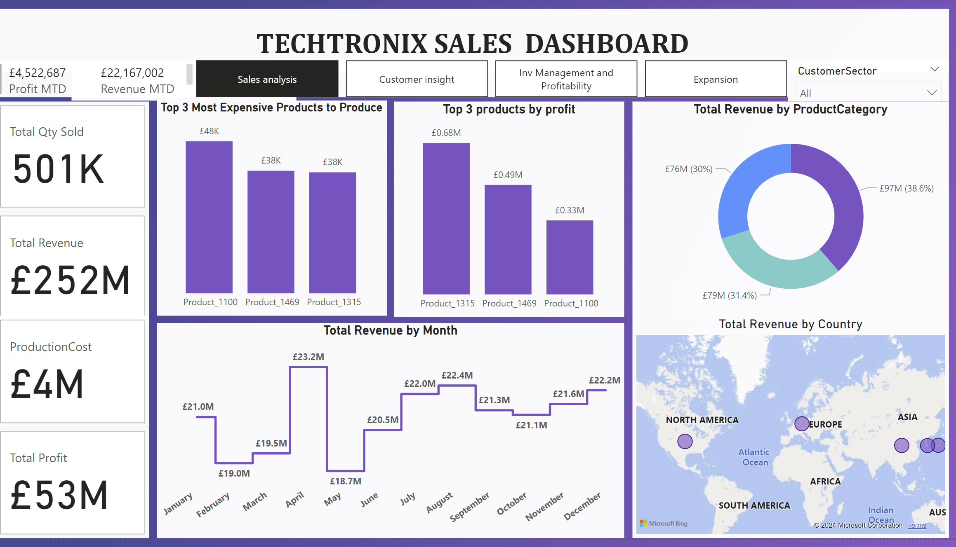
Recommendations
Recommendations:
Focus on High-Growth Regions: Allocate more resources to North America and Europe for the automotive sector. Consider expanding the product line to capture the growing EV market.
Revitalize Consumer Electronics: For the underperforming consumer electronics in Asia, adjust pricing strategies, introduce differentiated features, or target niche markets to regain competitiveness.
Seasonal Promotions: Launch targeted marketing campaigns ahead of peak seasons (Q2 and Q4) to maximize sales and inventory turnover during high-demand periods.

Slide 5

2. Customer Insights
Insights:
Key Customer Segments: High-value customers are predominantly from the industrial sector, with repeat purchases and higher average transaction values.
Sector Contribution: The automotive sector contributes the most to overall sales, followed by industrial, with the consumer electronics sector lagging.
Geographic Insights: The U.S. and Germany are top-performing regions, while South America shows untapped potential with rising demand in the industrial sector.

Slide 6
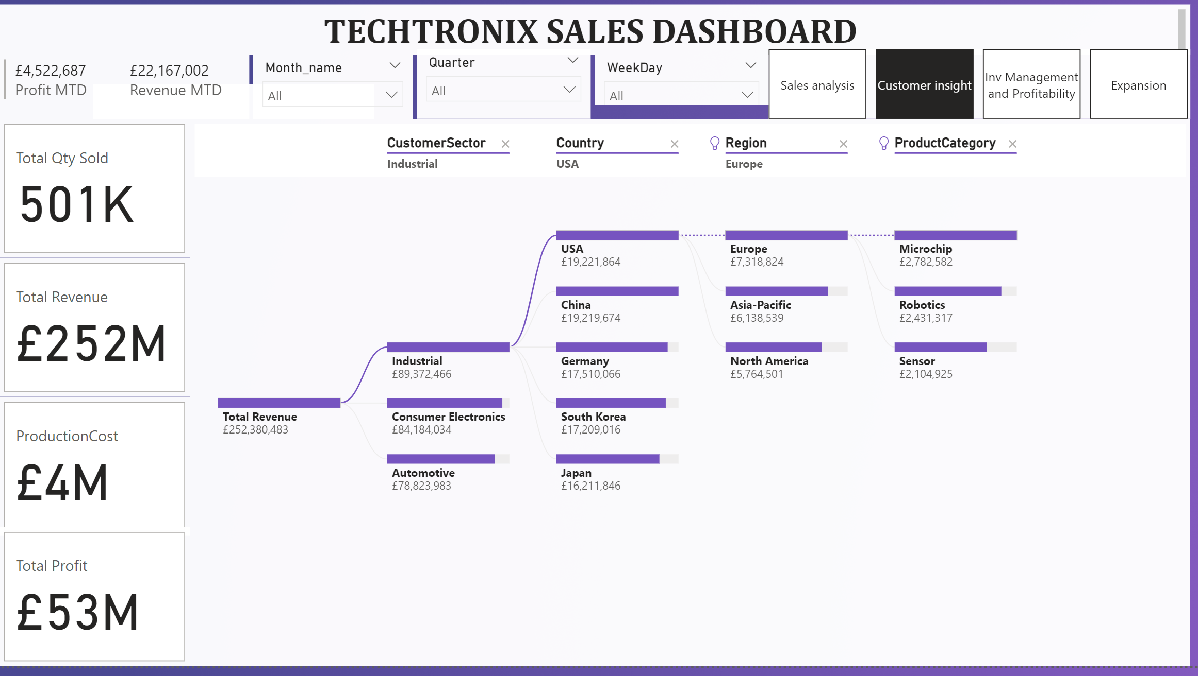
Recommendations
Target High-Value Segments: Develop loyalty programs and personalized offers for industrial sector customers to enhance retention and increase repeat purchases.
Expand Automotive Focus: Prioritize R&D investments in automotive-related products, as this sector drives the highest profitability.
Explore South American Market: Conduct a market entry analysis for South America, focusing on industrial products, and develop localized marketing strategies to capture new customers.

Slide 7
3. Inventory Optimization
Insights:
Inventory-Sales Mismatch: Overstocks are prevalent in the consumer electronics category, while frequent stockouts occur in the high-demand automotive parts.
Demand Forecast Errors: Forecasting inaccuracies in product launches lead to either excessive inventory or unmet demand, affecting sales potential and increasing holding costs.
Slow-Moving Inventory: Certain industrial components have high holding costs due to slow turnover, tying up capital that could be used elsewhere.

Slide 8
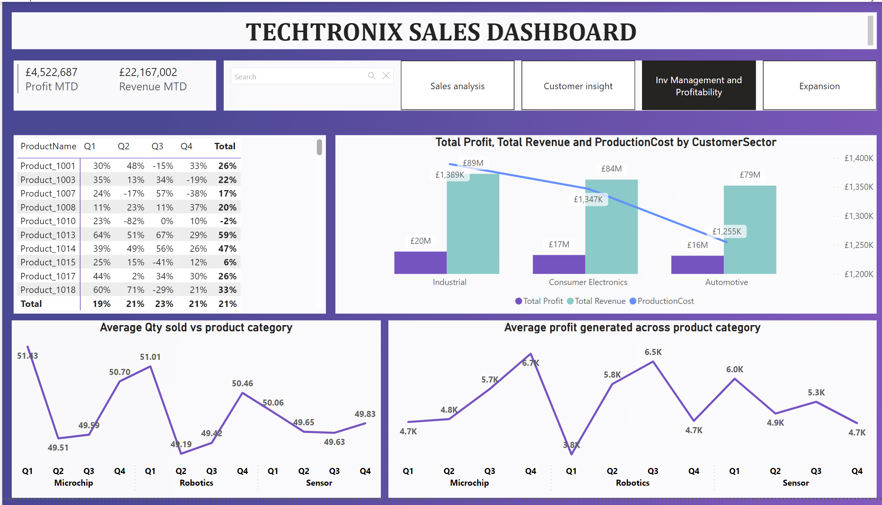
Recommendations
Dynamic Inventory Models: Implement advanced demand forecasting models like machine learning-based algorithms to improve accuracy and reduce mismatches.
Lean Inventory Practices: Introduce JIT (Just-In-Time) manufacturing to minimize excess stock and align production with real-time demand data.
Clearance Strategies: Implement clearance sales or bundle slow-moving products with high-demand items to free up warehouse space and improve cash flow.

Slide 9

4. Profitability Analysis
Insights:
High-Margin Products: Automotive microchips and certain industrial robotics components generate the highest margins due to proprietary technology and lower competition.
Low-Margin Products: Generic consumer electronics have low margins due to high production costs and competitive pricing pressures.
Cost Drivers: High production costs stem from expensive raw materials and suboptimal manufacturing processes, particularly in the consumer electronics line.

Slide 10
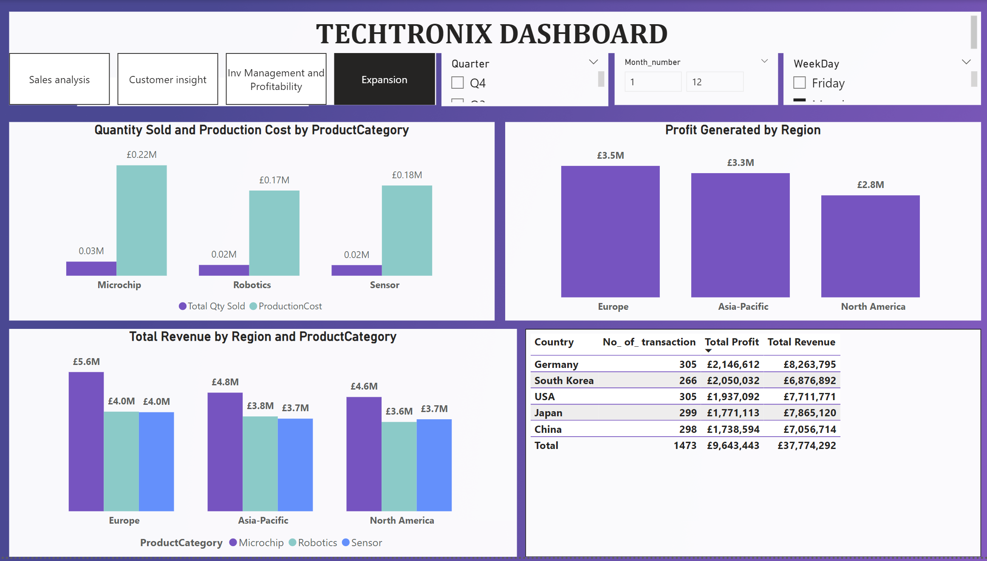
Recommendations
Enhance High-Margin Focus: Prioritize marketing and sales efforts on high-margin products, such as automotive microchips, to maximize profitability.
Cost Reduction Strategies: Negotiate bulk purchasing agreements with suppliers, automate production processes, and explore alternative materials to reduce production costs.
Re-engineering Low-Margin Products: Consider redesigning or enhancing features of low-margin consumer electronics to differentiate them and justify premium pricing.

Slide 11

5. Market Expansion Opportunities
Insights:
Untapped Markets: Eastern Europe and Southeast Asia show potential for market expansion, particularly for industrial robotics due to increasing automation trends.
Sector Opportunities: The growing renewable energy sector offers new avenues, with rising demand for specialized microchips used in solar and wind power systems.
Competitive Landscape: Competitors have limited presence in the industrial sectors of emerging markets, presenting a strategic opportunity for Techtronix.

Slide 12
Recommendations
Expand into Emerging Markets: Develop an entry strategy for Eastern Europe and Southeast Asia, focusing on establishing local partnerships and adapting products to meet regional needs.
Diversify Product Offerings: Explore new product lines tailored to the renewable energy sector, such as chips for smart grids and energy-efficient robotics.
Market Penetration Initiatives: Leverage competitive advantages such as advanced technology and strong brand reputation to enter new markets with aggressive marketing and sales tactics.

Slide 13

Overall Strategic Recommendations
Invest in Data-Driven Decision Making: Continuously refine predictive models for sales, demand forecasting, and inventory management to align production with market needs.
Optimize Product Portfolio: Focus on high-margin, high-growth products and sectors, phasing out underperforming lines or re-engineering them to capture more value.
Strengthen Customer Relationships: Develop personalized customer experiences and loyalty programs targeting high-value segments to drive repeat sales.
Expand Geographically: Focus expansion efforts on regions with proven demand potential and lower competitive pressure to diversify revenue streams and reduce market risk.

Slide 14


